Slide 1
SAP EUDAMED Add-On Training
Version V2022/02

Slide 3
Agenda
1
Introduction
UDI SAP Add-On (EU)
Code lists
UDI program settings
UDI transactions
UDI transaction codes
2
Working process from data creation to data transmission
UDI relevant marking
Product creation in the Add-On
Product creation with Excel
Mass change
Data overview, visual data check /UDI/Attributes
Integrity check, validation check
Data release
Excel export
XML export
Europe IT Consulting Web Service
3
Appendix

Slide 4

1. Introduction
PLEASE ACTIVATE THE PRESENTATION MODE !

Slide 5
1. Introduction
1.1 SAP EUDAMED Add-On
According to the regulatory requirements of the European Union, all medical devices sold in the EU market must be registered in the European Database for Medical Devices (EUDAMED).
The UDI SAP Add-On (EU) enables companies the administration of UDI master data in SAP.
The UDI SAP Add-On (EU) enables the maintenance of UDI attributes in SAP. The UDI attributes and their characteristics have been defined by EUDAMED.
The functionality of UDI Add-On (EU) has been divided into three sections.

Slide 6
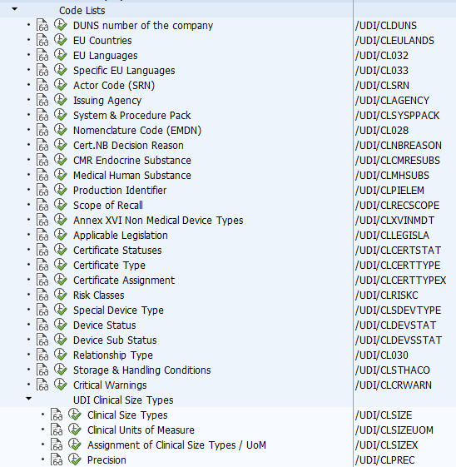
1. Introduction
1.2 Code Lists
Within these SAP transactions, default values are defined for the dropdown lists in UDI master data maintenance.
For this purpose, unit value ranges as well as approval data acquired by the respective company are defined.
In addition, these values serve as an input check and during data upload for the data validation.

Slide 7
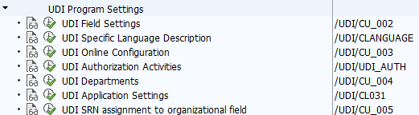
1. Introduction
1.3 UDI Program Settings
Basic settings of the application are made in this area. The settings affect the UDI maintenance transaction and the permissions. They also have an impact on the layout.

Slide 8
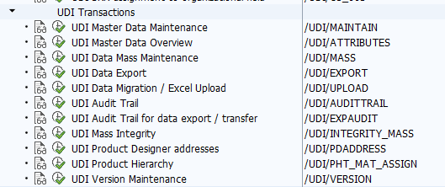
1. Introduction
1.4 UDI Transactions
This category includes all applications where you can maintain, evaluate, release and export the UDI attributes.

Slide 9
1. Introduction
UDI Program Settings
1.5 UDI transaction codes
UDI Field Settings /UDI/CU_002
UDI Specific Language Description /UDI/CLANGUAGE
UDI Online Configuration /UDI/CU_003
UDI Authorization Activities /UDI/CL025
UDI Departments /UDI/CU_004
UDI Application settings /UDI/CL031
UDI SRN assignment to organizational field /UDI/CU_005
To execute a transaction, the following procedure must be followed: /n/UDI/MAINTAIN
It is also possible to store frequently used transactions as favorites or start the Area Menu with the transaction /n/UDI/EU in the SAP user menu.
Code Lists
UDI Transactions
DUNS number of the company /UDI/CL029
EU countries /UDI/CL026
EU Languages /UDI/CL032
Specific EU Languages /UDI/CL033
Actor Code (SRN) /UDI/CL027
Issuing Agency /UDI/CL001
System & Procedure Pack /UDI/CL022
Nomenclature Code (EMDN) /UDI/CL028
Cert.NB Decision Reason /UDI/CL023
CMR Endoctrine Substance /UDI/CL021
Medical Human Substance /UDI/CL020
Production Identifier /UDI/CL019
Scope of Recall /UDI/CL018
Annex XVI Non Medical Device Types /UDI/CL012
Applicable Legislation /UDI/CL004
Certificate Type /UDI/CL002
Certification Status /UDI/CL034
Certificate Assignment /UDI/CL036
Risk Classes /UDI/CL008
Special Device Type /UDI/CL009
Device Status /UDI/CL010
Device Sub Status /UDI/CL024
Relationship Type /UDI/CL030
Storage Handling Conditions /UDI/CL013
Critical Warnings /UDI/CL014
Clinical Size Types /UDI/CL015
Clinical Units of measure /UDI/CL035
Assignment of Clinical Size Types/ UoM /UDI/CL016
Precision /UDI/CL017
UDI Master Data Maintenance /UDI/MAINTAIN
UDI Master Data Overview /UDI/ATTRIBUTES
UDI Data Mass Maintenance /UDI/MASS
UDI Data Export /UDI/EXPORT
UDI Data Migration /UDI/UPLOAD
UDI Audit Trail /UDI/AUDITTRAIL
UDI Audit Trail for Data Export /UDI/EXPAUDIT
UDI Mass Integrity /UDI/INTEGRITY_MASS
UDI Product Hierarchy /UDI/PHT_MAT_ASSIGN
UDI Product Designer Addresses /UDI/PDADDRESS
UDI Product Hierarchy /UDI/PHT_MAT_ASSIGN
UDI Version Maintenance /UDI/VERSION

Slide 10
2. Work processes from the database to data transmission
UDI relevant marking
Product creation in the Add-On
Product creation with Excel
Data transmission
3rd Party
E
U
D
A
M
E
D
Excel export
XML export
WebTrader
Mass change
with Excel
in the Add-On
Data overview,
visual data check
/UDI/Attributes
Europe IT Consulting Web Service
WebService
(SSL)
Integrity check
Validation check
Data release /
Lock trigger fields

Slide 11
2. Work processes from the database to data transmission
2.1 UDI relevant marking
UDI relevant marking
Product creation in the Add-On
Product creation with Excel
Data transmission
3rd Party
E
U
D
A
M
E
D
Excel export
XML export
WebTrader
Mass change
with Excel
in the Add-On
Data overview,
visual data check
/UDI/Attributes
Europe IT Consulting Web Service
WebService
(SSL)
Integrity check
Validation check
Data release /
Lock trigger fields

Slide 12
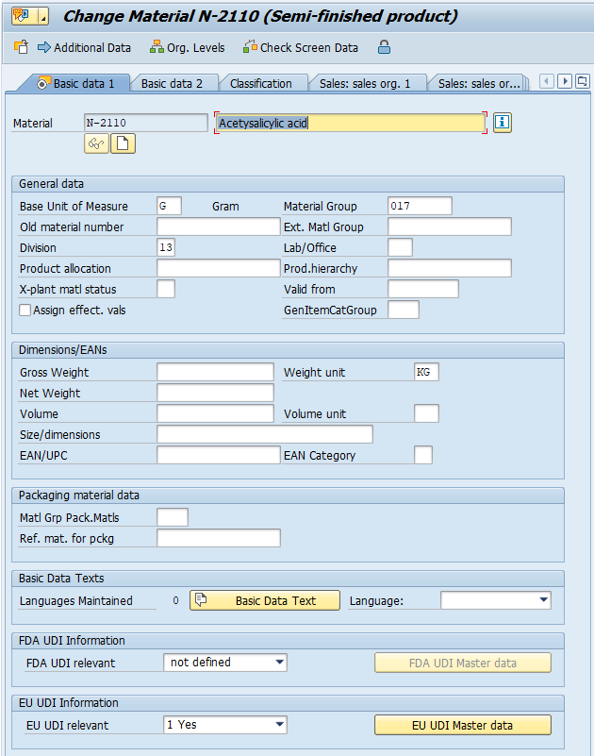
2. Work processes from the database to data transmission
2.1 UDI relevant marking
One of the biggest differences between the FDA and EC requirements is that in the EU database the data must have a Basic UDI-DI and a UDI-DI.
For this reason, a product must first be assigned to a Basic UDI-DI before it is possible to jump directly from here via the "EU UDI Master Data" button.
The next step is to create a Basic UDI-DI and assign a product to it.

Slide 13
2. Work processes from the database to data transmission
2.1 UDI relevant marking
Access via transactions MM02/MM03
Enter a material number
Set the EU UDI relevance to “1 Yes”
Do not forget to save!

Slide 14
2. Work processes from the database to data transmission
2.2 Product creation in the Add-On
UDI relevant marking
Product creation in the Add-On
Product creation with Excel
Data transmission
3rd Party
E
U
D
A
M
E
D
Excel export
XML export
WebTrader
Mass change
with Excel
in the Add-On
Data overview,
visual data check
/UDI/Attributes
Europe IT Consulting Web Service
WebService
(SSL)
Integrity check
Validation check
Data release /
Lock trigger fields

Slide 15
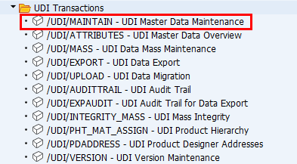
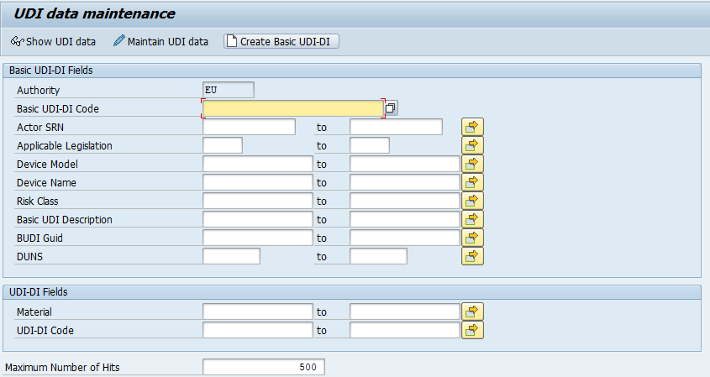
2. Work processes from the database to data transmission
2.2 Product creation in the Add-On
Enter /n/UDI/EU to access the UDI transactions or directly enter the UDI data maintenance transaction /UDI/MAINTAIN
To maintain a new UDI data record, click on “Create Basic UDI-DI”
1

Slide 16
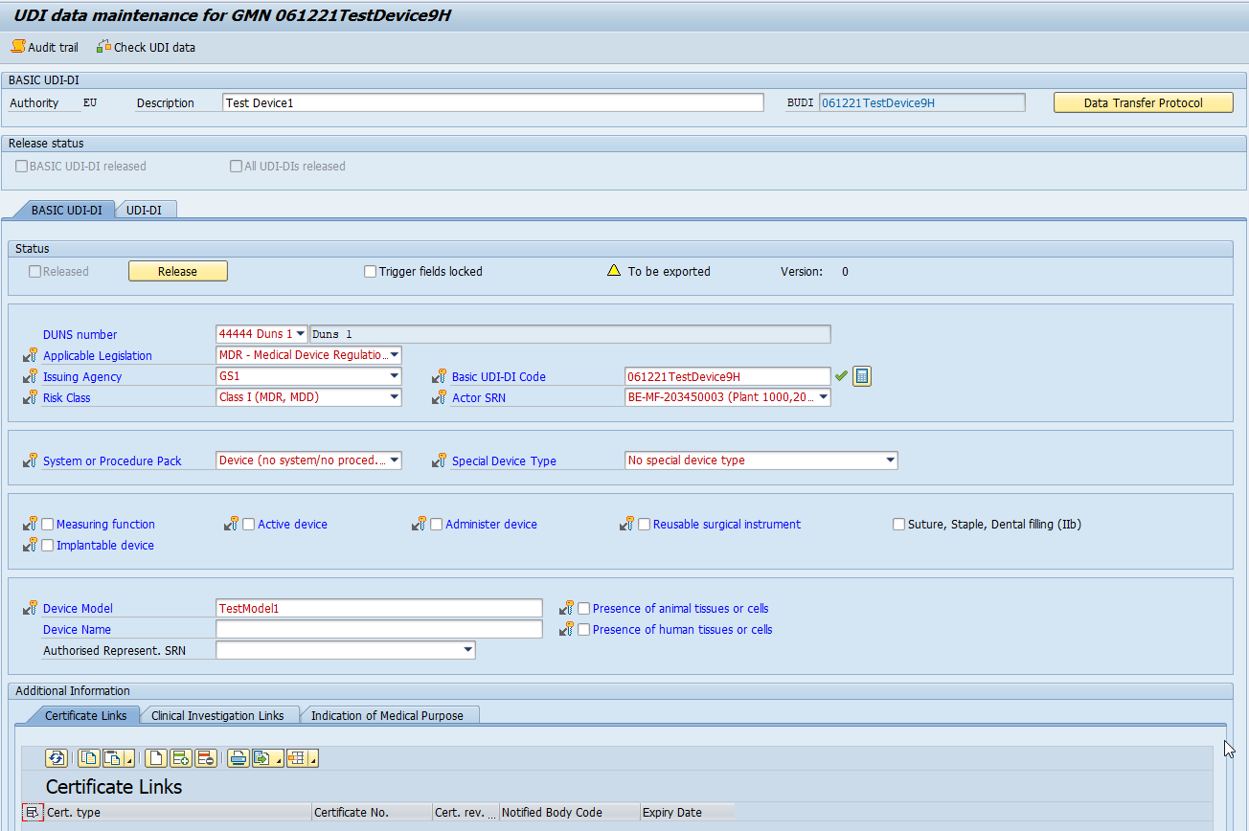
2. Work processes from the database to data transmission
2.2 Product creation in the Add-On
Maintain the UDI information for the Basic UDI-DI
2

Slide 17
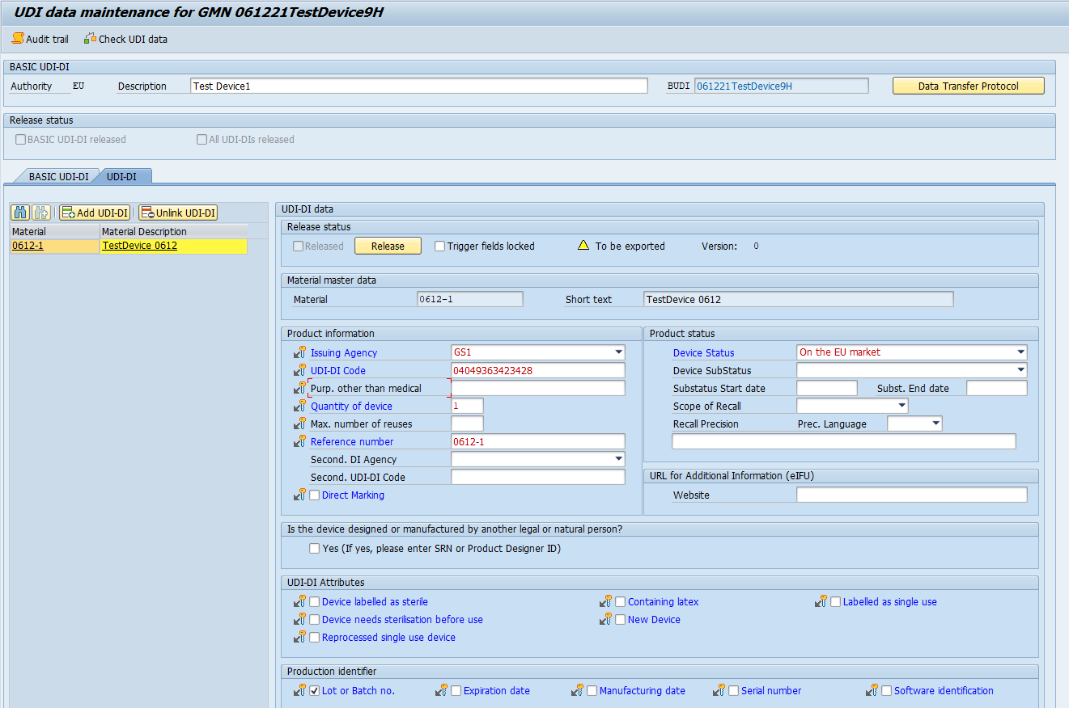
2. Work processes from the database to data transmission
2.2 Product creation in the Add-On
On the UDI-DI level: add the UD EU relevant material to the Basic UDI-DI
3

Slide 18
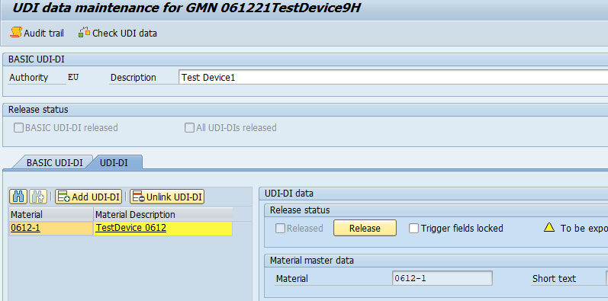
2. Work processes from the database to data transmission
2.2 Product creation in the Add-On
Finish the UDI data maintenance with the UDI data check.
Don’t forget to save!
4

Slide 19
2. Work processes from the database to data transmission
2.3 Product creation with Excel
UDI relevant marking
Product creation in the Add-On
Product creation with Excel
Data transmission
3rd Party
E
U
D
A
M
E
D
Excel export
XML export
WebTrader
Mass change
with Excel
in the Add-On
Data overview,
visual data check
/UDI/Attributes
Europe IT Consulting Web Service
WebService
(SSL)
Integrity check
Validation check
Data release /
Lock trigger fields

Slide 20
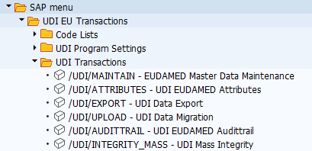
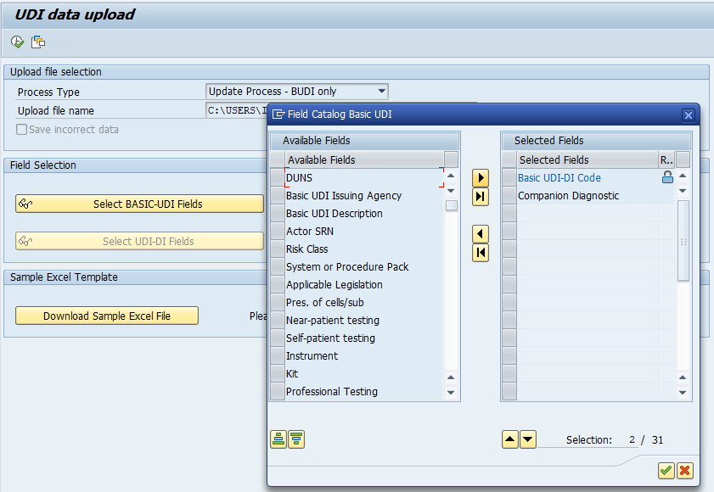
2. Work processes from the database to data transmission
2.3 Product creation with Excel
Enter /n/UDI/EU to access the UDI transactions or directly enter the UDI data migration transaction /UDI/UPLOAD
Fill in the “UDI EU data upload template.xlsx” to upload UDI data
  The template can be downloaded in the transaction
For the upload of new UDI data record select the “Process Type” – “Insert Process…”
For the upload of changes of an existing UDI data record select the “Process Type” – “Update Process…”
If only certain Basic UDI-DI or UDI-DI information should be added/ changed, select the relevant fields in the “Available Fields“
Execute the upload
4
1
2
3

Slide 21
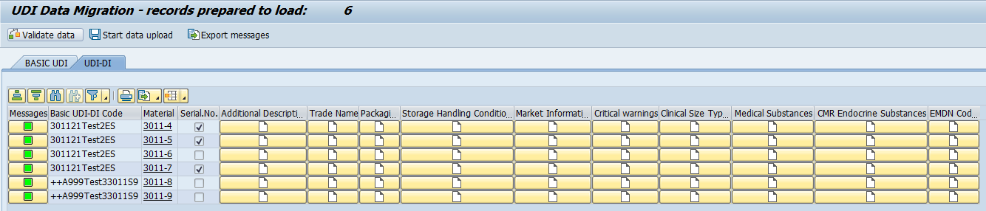
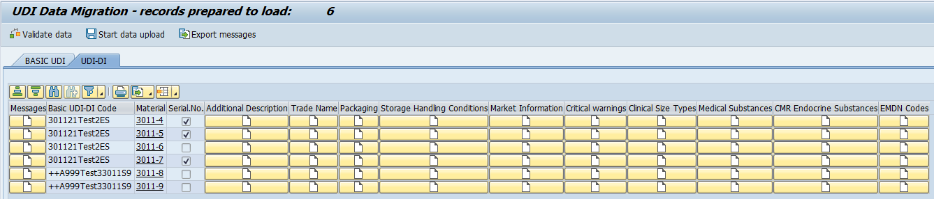
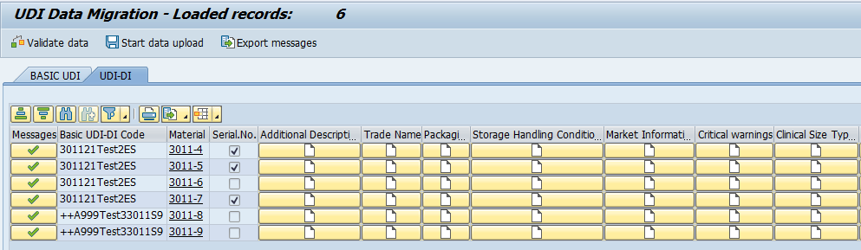
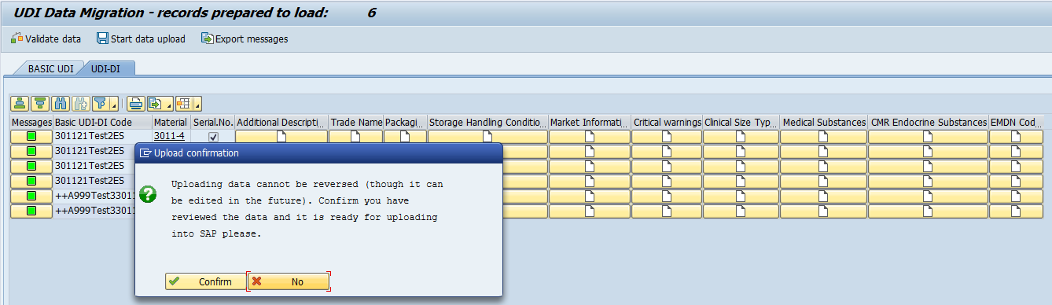
2. Work processes from the database to data transmission
2.3 Product creation with Excel
Perfom the UDI data check
Upload the UDI data
5
6
7

Slide 22
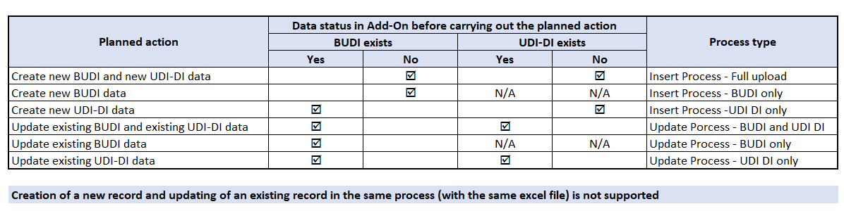
2. Work processes from the database to data transmission
2.3 Product creation with Excel

Slide 23
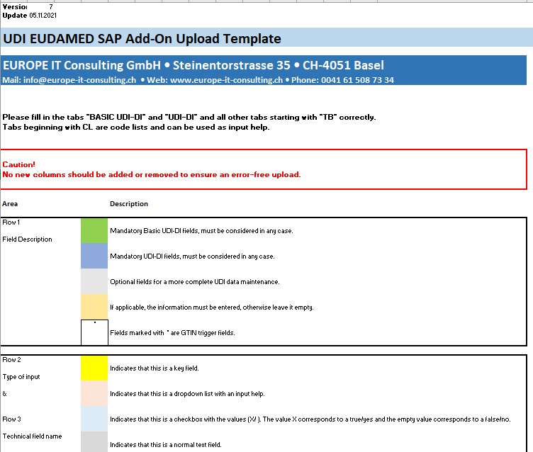
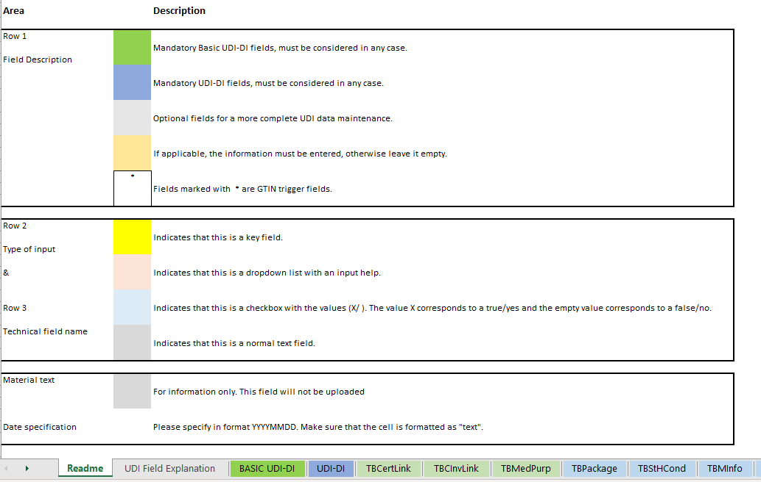
2. Work processes from the database to data transmission
2.3 Product creation with Excel
Excerpt from the “UDI EU data upload template.xlsx”

Slide 24
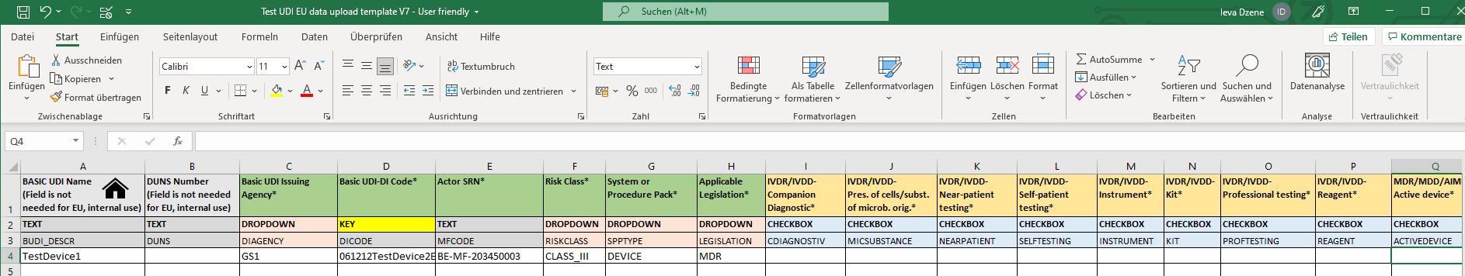
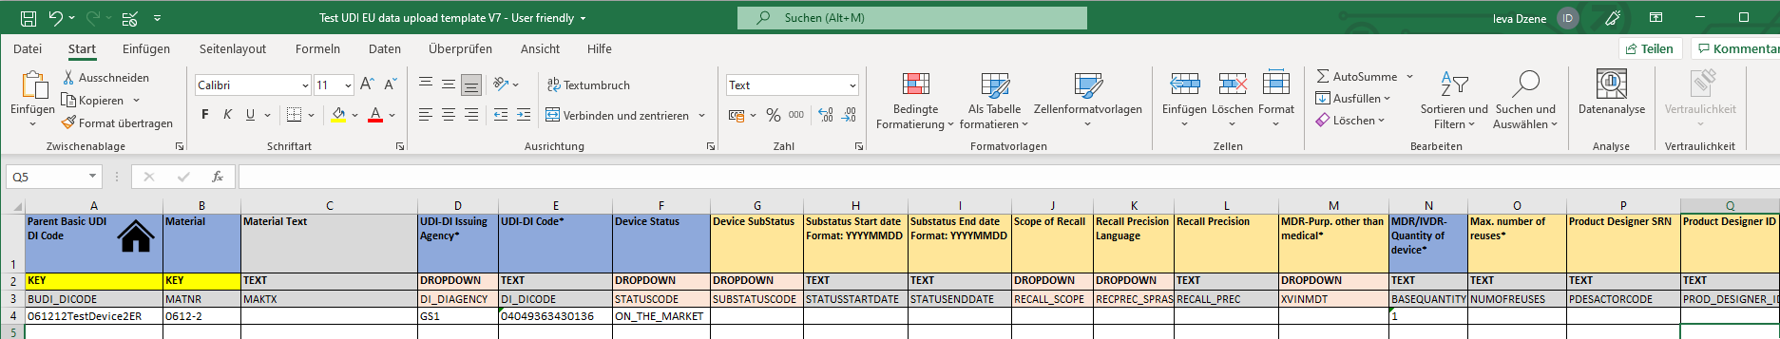
2. Work processes from the database to data transmission
2.3 Product creation with Excel
Excerpt from the “UDI EU data upload template.xlsx”

Slide 25
2. Work processes from the database to data transmission
2.4 Mass change with Excel
UDI relevant marking
Product creation in the Add-On
Product creation with Excel
Data transmission
3rd Party
E
U
D
A
M
E
D
Excel export
XML export
WebTrader
Mass change
with Excel
in the Add-On
Data overview,
visual data check
/UDI/Attributes
Europe IT Consulting Web Service
WebService
(SSL)
Integrity check
Validation check
Data release /
Lock trigger fields

Slide 26
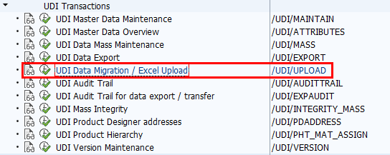
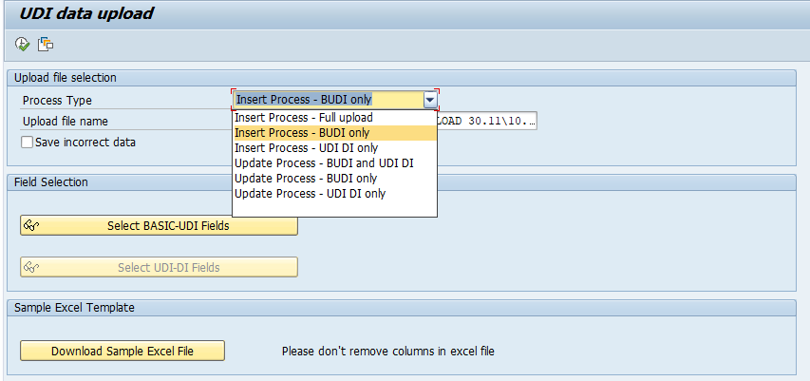
2. Work processes from the database to data transmission
2.4 Mass change with Excel

Slide 27
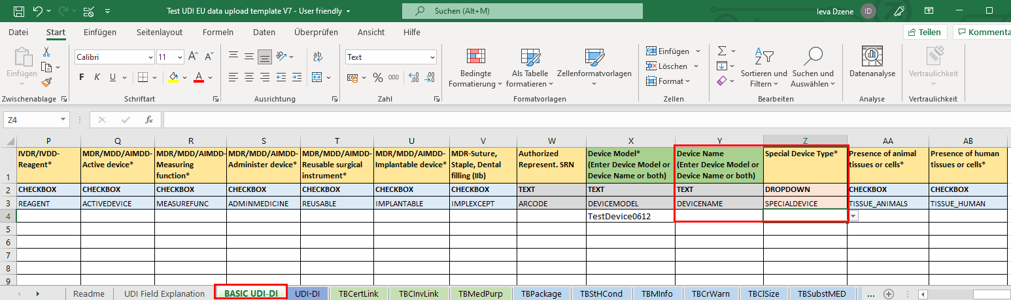
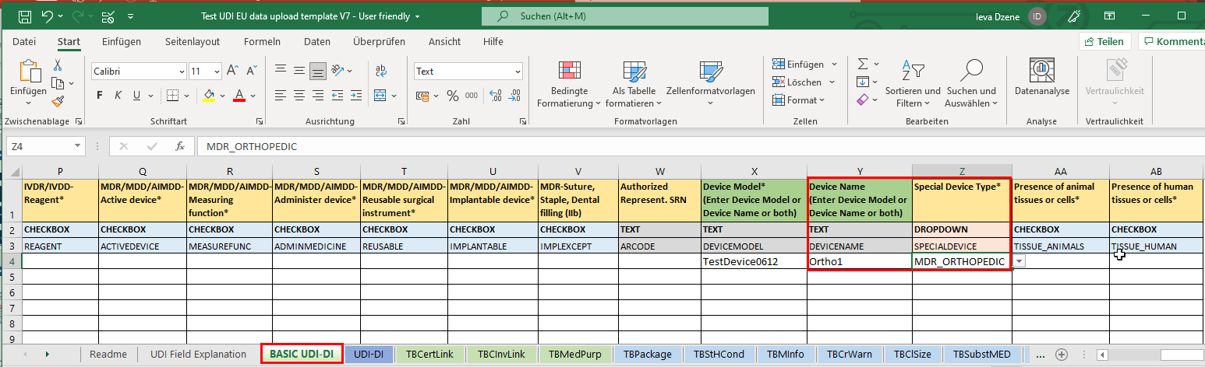
2. Work processes from the database to data transmission
2.4 Mass change with Excel
Before
After

Slide 28
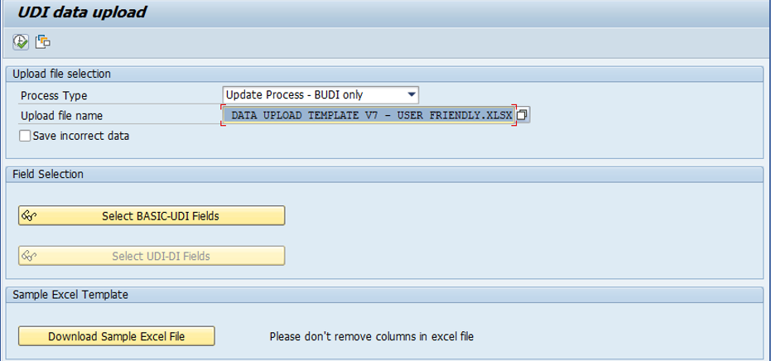
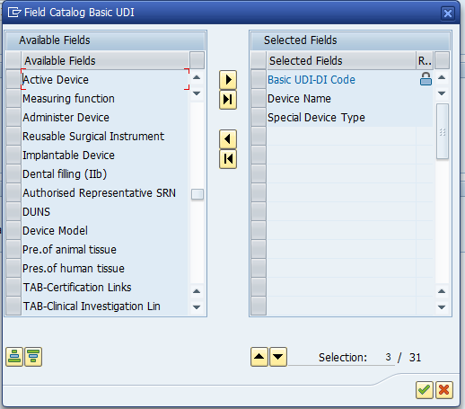
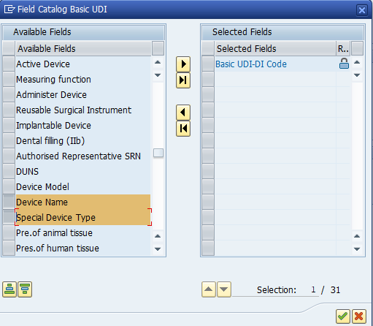
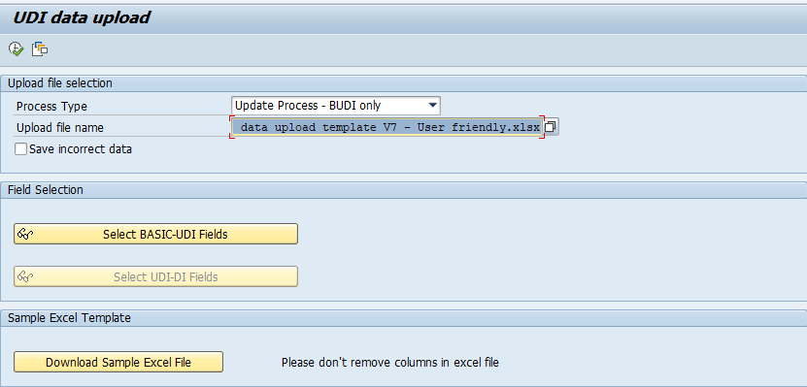
2. Work processes from the database to data transmission
2.4 Mass change with Excel

Slide 29
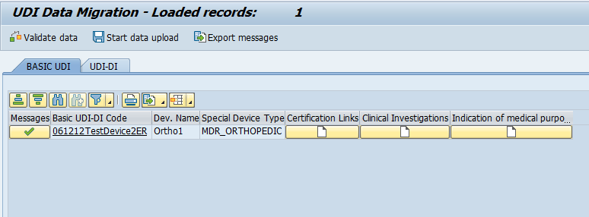
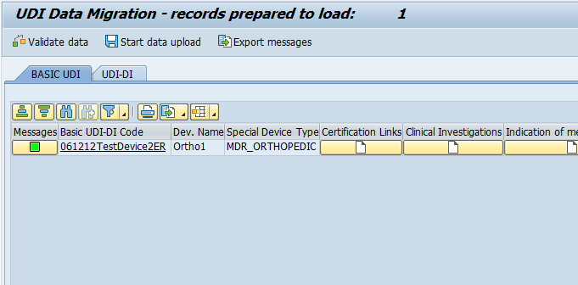
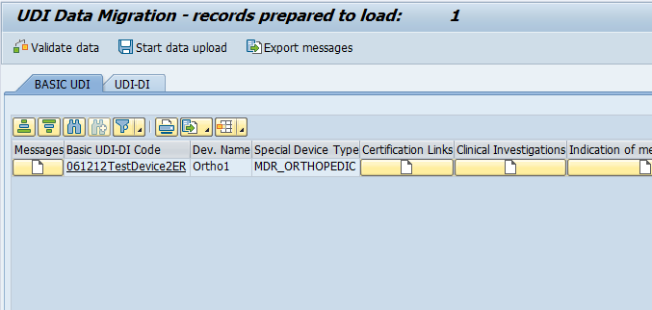
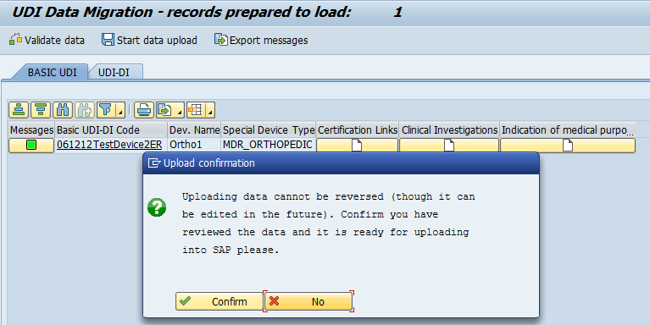
2. Work processes from the database to data transmission
2.4 Mass change with Excel

Slide 30
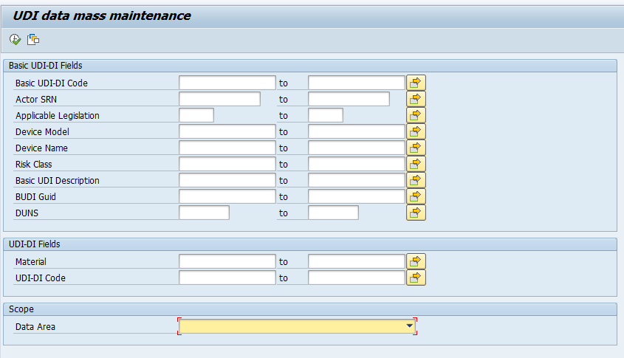
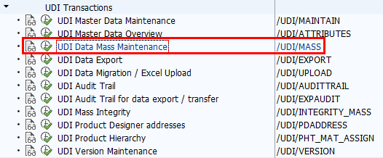
2. Work processes from the database to data transmission
2.4 Mass change in the Add-On
Enter /n/UDI/EU to access the UDI transactions or directly enter the UDI data mass maintenance transaction /UDI/MASS
Select the “Data Area” for the mass change, either “Basic UDI-DI” or “UDI-DI”
1

Slide 31
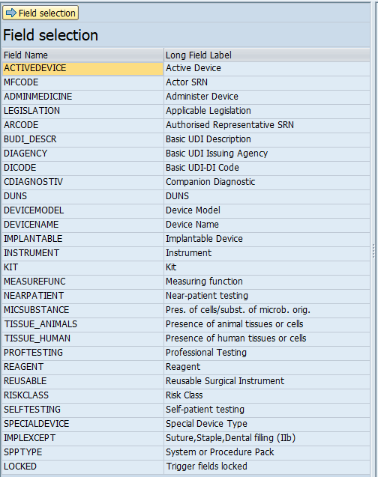
2. Work processes from the database to data transmission
2.4 Mass change in the Add-On
2
Select the UDI field that needs to be changed

Slide 32
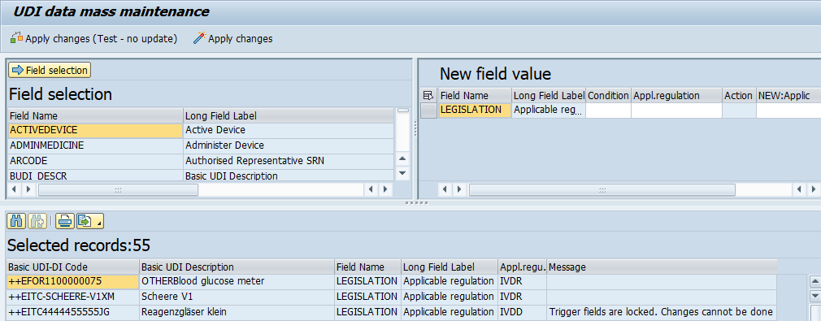
2. Work processes from the database to data transmission
2.4 Mass change in the Add-On
All affected UDI records will be listed below
In the section “New field value” enter the new value for the mass change
Apply the changes in the test mode
Execute the mass change with “Apply changes”
5
6
4
3

Slide 33
2. Work processes from the database to data transmission
2.5 Data overview, Visual inspection /UDI/Attributes
UDI relevant marking
Product creation in the Add-On
Product creation with Excel
Data transmission
3rd Party
E
U
D
A
M
E
D
Excel export
XML export
WebTrader
Mass change
with Excel
in the Add-On
Data overview,
visual data check
/UDI/Attributes
Europe IT Consulting Web Service
WebService
(SSL)
Integrity check
Validation check
Data release /
Lock trigger fields

Slide 34
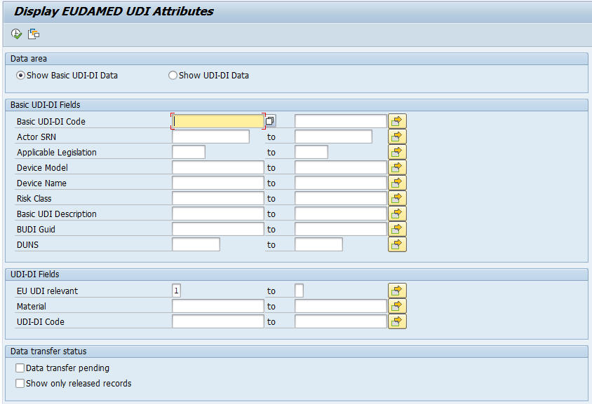
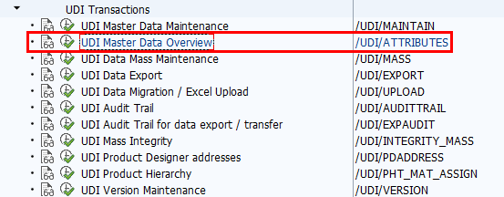
2. Work processes from the database to data transmission
2.5 Data overview, visual data check /UDI/Attributes
Enter /n/UDI/EU to access the UDI transactions or directly enter the UDI overview transaction /UDI/ATTRIBUTES
Select the data area that you want to be see, either “Show Basic UDI Data” or “Show UDI-DI Data” and execute
2
1

Slide 35
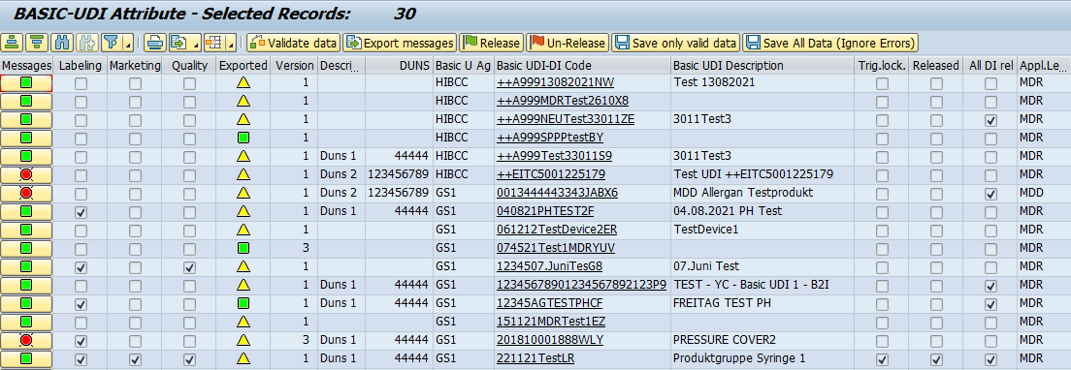
2. Work processes from the database to data transmission
2.5 Data overview, visual data check /UDI/Attributes
All UDI data of the selected data area will be displayed
Further options, such as the data validation, release and saving are available
3

Slide 36
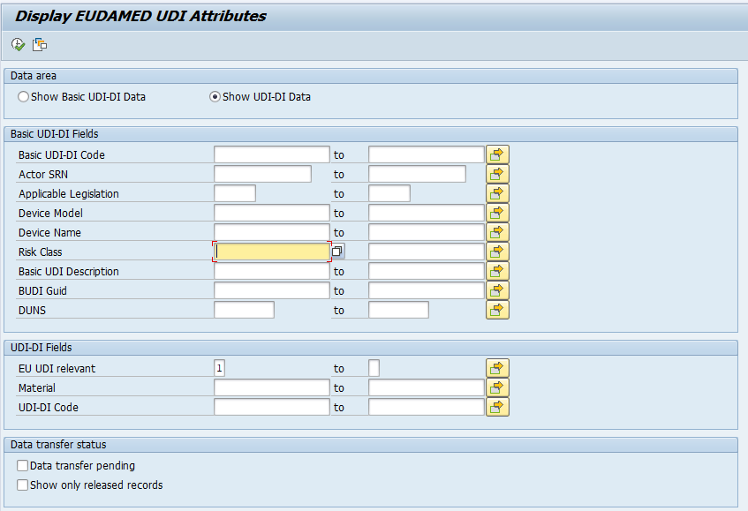
2. Work processes from the database to data transmission
2.5 Data overview, visual data check /UDI/Attributes
2
1

Slide 37
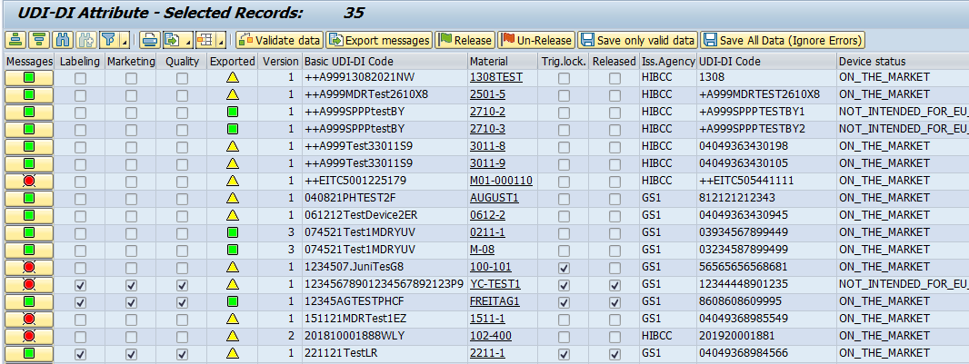
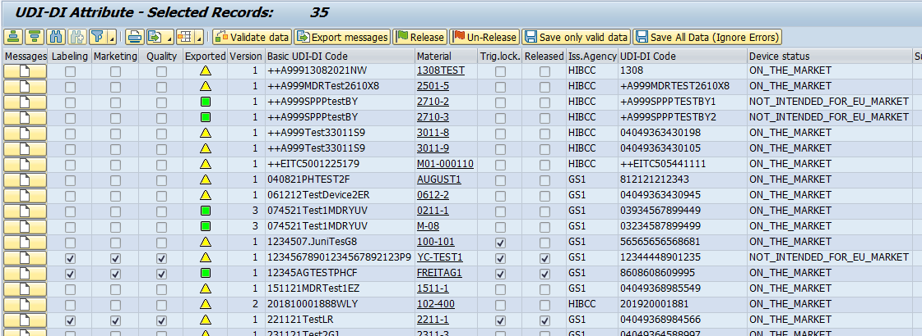
2. Work processes from the database to data transmission
2.5 Data overview, visual data check /UDI/Attributes

Slide 38
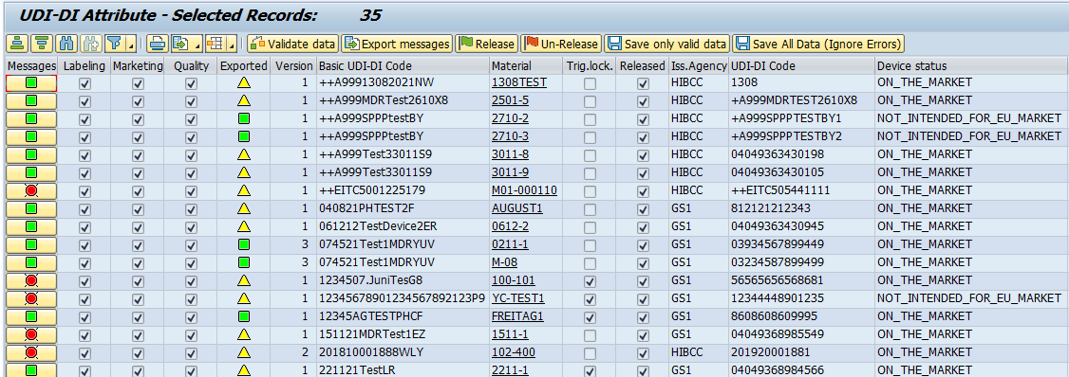
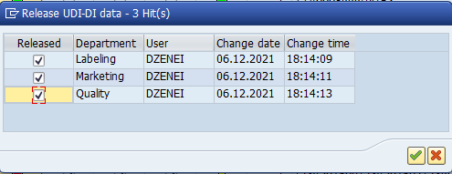
2. Work processes from the database to data transmission
2.5 Data overview, visual data check /UDI/Attributes

Slide 39
2. Work processes from the database to data transmission
2.6 Integrity check, Validation check
UDI relevant marking
Product creation in the Add-On
Product creation with Excel
Data transmission
3rd Party
E
U
D
A
M
E
D
Excel export
XML export
WebTrader
Mass change
with Excel
in the Add-On
Data overview,
visual data check
/UDI/Attributes
Europe IT Consulting Web Service
WebService
(SSL)
Integrity check
Validation check
Data release /
Lock trigger fields

Slide 40
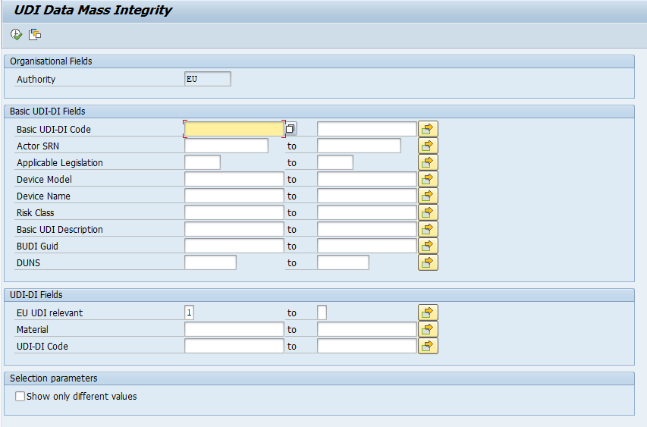
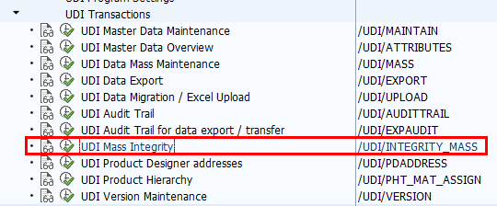
2. Work processes from the database to data transmission
2.6 Integrity check, Validation check
Enter /n/UDI/EU to access the UDI transactions or directly enter the UDI mass integrity transaction /UDI/INTEGRITY_MASS
Execute the transaction to check the integrity of all UDI data
1

Slide 41
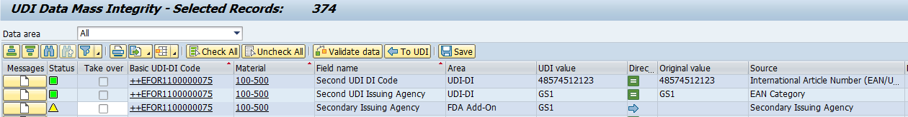
2. Work processes from the database to data transmission
2.6 Integrity check, Validation check
Check which datasets are not integrated and show different UDI values in EUDAMED and FDA
Select the datasets with integrity issues and determine which value to take over
Validate the UDI data and save
5
4
6
3
2

Slide 42
2. Work processes from the database to data transmission
2.7 Data release
UDI relevant marking
Product creation in the Add-On
Product creation with Excel
Data transmission
3rd Party
E
U
D
A
M
E
D
Excel export
XML export
WebTrader
Mass change
with Excel
in the Add-On
Data overview,
visual data check
/UDI/Attributes
Europe IT Consulting Web Service
WebService
(SSL)
Integrity check
Validation check
Data release /
Lock trigger fields

Slide 43
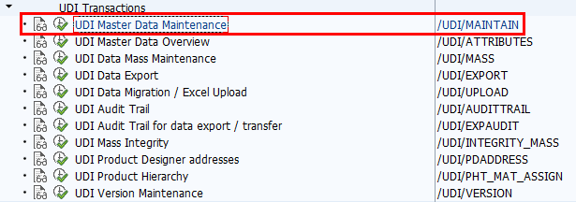
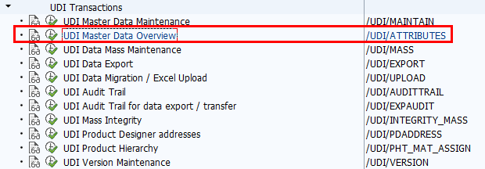
2. Work processes from the database to data transmission
2.7 Data release
Data sets must be released at Basic UDI-DI and UDI-DI level so that data transfer can take place.
The release can be made for an individual material as well as in the overview (for several materials).

Slide 44
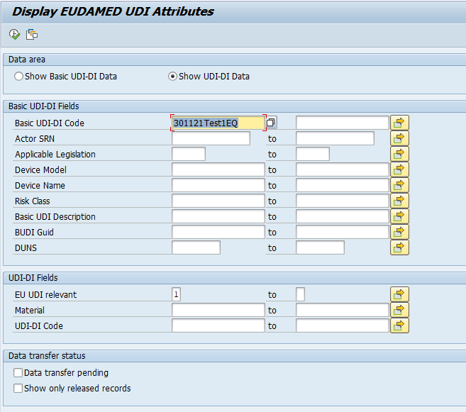
2. Work processes from the database to data transmission
2.7 Data release
3
Release via the UDI master data overview
2
1

Slide 45






2. Work processes from the database to data transmission
2.7 Data release
If the parameter “LOCK_AFTER_RELEASE” is set in Application Settings, trigger fields are locked automatically after all releases have been set.

Slide 46

2. Work processes from the database to data transmission
2.7 Data release
Release via UDI master data maintenance
2
1

Slide 47





2. Work processes from the database to data transmission
2.7 Data release
If the parameter “LOCK_AFTER_RELEASE” is set in Application Settings, trigger fields are locked automatically after all releases have been set.

Slide 48
2. Work processes from the database to data transmission
2.8 Excel export
UDI relevant marking
Product creation in the Add-On
Product creation with Excel
Data transmission
3rd Party
E
U
D
A
M
E
D
Excel export
XML export
WebTrader
Mass change
with Excel
in the Add-On
Data overview,
visual data check
/UDI/Attributes
Europe IT Consulting Web Service
WebService
(SSL)
Integrity check
Validation check
Data release /
Lock trigger fields

Slide 49



2. Work processes from the database to data transmission
5
2.8 Excel export
1
2
3
4
6

Slide 50


2. Work processes from the database to data transmission
2.8 Excel export

Slide 51
2. Work processes from the database to data transmission
2.9 XML export
UDI relevant marking
Product creation in the Add-On
Product creation with Excel
Data transmission
3rd Party
E
U
D
A
M
E
D
Excel export
XML export
WebTrader
Mass change
with Excel
in the Add-On
Data overview,
visual data check
/UDI/Attributes
Europe IT Consulting Web Service
WebService
(SSL)
Integrity check
Validation check
Data release /
Lock trigger fields

Slide 52


2. Work processes from the database to data transmission
6
2.9 XML export
1
2
3
4
5
7

Slide 53


2. Work processes from the database to data transmission
2.9 XML export
The Basic UDI-DI and the corresponding UDI-DIs are exported according to the settings in the selection screen (in the example below a new subfolder was created, and multiple UDI records were merged into a single XML file):

Slide 54

2. Work processes from the database to data transmission
2.9 XML export
Defined by EUDAMED, there exist 4 different XML file structures. These file structures are:
Insert action with 1 x Basic UDI-DI and 1-n UDI-DI (to EUDAMED database)
Update 1 x Basic UDI-DI (in EUDAMED database)
Add 1-n UDI-DI to existing Basic UDI-DI (in EUDAMED database)
Update 1-n UDI-DI (in EUDAMED database)
The option “Merge multiple XML files into a single XML file” will create only one file for all same action types. This allows you to have less manual upload effort.
The option “System controlled” will determine if a UDI record was already exported and which version this record has. Depending on these parameters the program will create one of above XML file types. All other options are forcing the program to create the selected file type.

Slide 55


2. Work processes from the database to data transmission
2.9 XML export

Slide 56
2. Work processes from the database to data transmission
2.10 EITC Web Service
UDI relevant marking
Product creation in the Add-On
Product creation with Excel
Data transmission
3rd Party
E
U
D
A
M
E
D
Excel export
XML export
WebTrader
Mass change
with Excel
in the Add-On
Data overview,
visual data check
/UDI/Attributes
Europe IT Consulting Web Service
WebService
(SSL)
Integrity check
Validation check
Data release /
Lock trigger fields

Slide 57

2. Work processes from the database to data transmission
2.10 EITC Web Service
Web Service Transfer is still not released and functional.
1
2
3

Slide 58


2. Work processes from the database to data transmission
2.10 EITC Web Service
4
Web Service Transfer is still not released and functional.
5

Slide 59





2. Work processes from the database to data transmission
2.10 EITC Web Service
Europe IT
AS4 Service
EUDAMED
SAP
FDA WTHS
GUDID
AS4
Service
UDI
Service
AS4 Receiver Service
Manueller Datei Upload
XML
WebConnector
(SSL/Restful)
UDI EUDAMED
Add-On
EU WebTrader
EUDAMED
XML Export
Excel Export
Web UI
Third Party

Slide 60
Appendix – Version Maintenance
What can I do in the UDI Version maintenance application?
The version maintenance application allows you to change/maintain the internal version number of the following data areas:
Basic UDI-DI
  BUDI - Clinical Investigation Links
  BUDI – Certification Links
UDI-DI
  DI – Market Information
  DI – Packaging Hierarchy
Why do I need this application?
Each data area has a version number, which exists only because the EUDAMED database expects this information in the XML file.
The idea of the EUDAMED is to keep the UDI record in your UDI data management system and the UDI data in the EUDAMED synchronous.
Usually the version number is managed by the UDI Add-On. But if the version in the UDI Add-On differs from the version in the EUDAMED, you need to correct the version number in UDI Add-On.
This can happen when:
somebody changes the UDI data directly in EUDAMED and creates a new version there.
UDI XML upload fails and you have to maintain and release the UDI data again in the UDI add-On.

Slide 61
Appendix – Version Maintenance
Example
When a UDI record has the version “2” in EUDAMED and you want to upload a XML file with a newer version number “3”,
then the XML file should contain the last version in EUDAMED, which is “2”.
As soon as the XML file is uploaded successfully in EUDAMED, the version number will be incremented by “1” to version number “3” in EUDAMED.
Exception:
For the initial XML file Upload the version number “1” is always used.
How does the UDI application handle this?
Each UDI data change, release and XML export is incrementing the version number for each changed area by 1, starting with version number 1.
The XML Export program is decrementing the existing version number in the XML file by 1 only if the version number greater than 1.
  Example:
    Exporting UDI record version 1  ➔ XML file will contain version 1 (no version number decrementing, because this is the initial version)
    Exporting UDI record version 2  ➔ XML file will contain version 1 (version number decrementing by 1)
    Exporting UDI record version 3  ➔ XML file will contain version 2 (version number decrementing by 1)
    Exporting UDI record version 4  ➔ XML file will contain version 3 (version number decrementing by 1)
    And so on…

Slide 62
Appendix – Version Maintenance
Which version number is EUDAMED expecting?
In the XML file you have to have the last version number which exists in EUDAMED.
When is the version number changed/incremented in the UDI Add-On?
When you did a change in the BASIC UDI data area in the transaction /UDI/MAINTAIN or any other data changing transaction:
The versions of BASIC UDI-DI, Clinical Investigation Links and Certification Links are incremented at the same time
When you did a change in the UDI-DI data area in the transaction /UDI/MAINTAIN or any other data changing transaction:
The versions of UDI-DI, Market Information and Packaging Hierarchy are incremented at the same time

Slide 63

Appendix – Version Maintenance
Which UDI areas belong together?
Basic UDI-DI
  BUDI - Clinical Investigation Links
  BUDI – Certification Links
UDI-DI
  DI – Market Information
  DI – Packaging Hierarchy
When is the UDI data shown as “Exported”?
Always when you export the UDI data as XML with the option “Mark records as sent after successful export”

Slide 64


Appendix – Version Maintenance – Changing a version number
Released data has been changed and XML Upload failed
Execute /UDI/VERSION
Choose the data area for which the version needs to be set back
Enter the old and the new value and apply the changes
Save the changes
Version number has been changed

Slide 65

Appendix - Assignment of SRN to organizational field
In the Program Settings, the transaction /UDI/CU_005 – UDI SRN assignment to organizational field – allows to assign SRN-s to different plants.
One plant can be assigned to one or more SRN-s and one SRN can be assigned to one or more plants.

Slide 66

Appendix - Assignment of SRN to organizational field
All UDI transactions will check if the materials (UDI-DIs) are assigned to the correct Basic UDI-DI which contains the SRN number as an UDI attribute.
Data access will be restricted based on the plant authorization of the user.

Slide 67


Appendix – Maintaining Data in the Tab Packaging in UDI/MAINTAIN
The data in the tab Packaging should be maintained according to the following scheme, in order to be uploaded in EUDAMED correctly:

Slide 68
Appendix - Workflow in Add-On: Use Cases
Adding a new or existing device to a new BASIC UDI-DI
Adding a new or existing device to an existing BASIC UDI-DI
Reassigning an existing UDI-DI to a new BASIC UDI-DI
Removing a device from the market
Changing a Directive Device (MDD, IVDD, AIMDD) to a Regulation Device (MDR, IVDR)

Slide 69






Appendix - Adding a new or existing device to a new BASIC UDI-DI
Device has to be added to a new BUDI
Maintain the UDI data in the sheet “BASIC UDI-DI”
Material
in SAP
exists
No
Create a material using the transaction MM01
Yes
Go to the sheet “UDI-DI” and add the material by clicking “Add UDI-DI”
Set the material as “EU UDI relevant” (Status 1, 2) in the Basic Data 1 of MM01/MM02
Maintain the UDI data in the sheet “UDI-DI”
Execute /UDI/MAINTAIN and click “Create Basic UDI-DI”
Device was added to a new BUDI

Slide 70
Appendix - Adding a new or existing device to a new BASIC UDI-DI
Device has to be added to a new BUDI
Material
in SAP
exists
No
Create a material using the transaction MM01
Set the material as “EU UDI relevant” (Status 1, 2) in the Basic Data 1 of MM02
Yes
Execute /UDI/MAINTAIN and click “Create Basic UDI-DI”
Maintain the UDI data in the sheet “BASIC UDI-DI”
Go to the sheet “UDI-DI” and add the material by clicking “Add UDI-DI”
Maintain the UDI data in the sheet “UDI-DI”
Device was added to a new BUDI

Slide 71
Appendix - Adding a new or existing device to an existing BASIC UDI-DI
Device has to be added to an existing BUDI
Material in SAP
exists
No
Create a material using the transaction MM01
Yes
Set the material as “EU UDI relevant” (Status 1, 2) in the Basic Data 1 of MM
Execute /UDI/MAINTAIN, enter the Basic UDI-DI Code and click “Maintain UDI data”
Go to the sheet “UDI-DI” and add the material by clicking “Add UDI-DI”
Maintain the UDI data in the sheet “UDI-DI”
Device was added to an existing BUDI

Slide 72
Appendix - Reassigning an existing UDI-DI to a new BASIC UDI-DI
UDI-DI has to be reassigned to a new BUDI
Execute /UDI/MAINTAIN, enter the search criteria for the existing record the and click “Maintain UDI data”
Go to the sheet “UDI-DI” and unlink the material by clicking
“Unlink UDI-DI”
No
New BASIC UDI-DI
exists
Yes
Execute /UDI/MAINTAIN and click “Create Basic UDI-DI”
Execute /UDI/MAINTAIN, enter the new Basic UDI-DI Code and click “Maintain UDI data”
Maintain the UDI data in the sheet “BASIC UDI-DI”
Go to the sheet “UDI-DI” and add the material by clicking “Add UDI-DI”
Go to the sheet “UDI-DI” and add the material by clicking “Add UDI-DI”
If necessary, adjust the UDI data in the sheet “UDI-DI” (*The UDI-DI data from the old record is transferred)
If necessary, adjust the UDI data in the sheet “UDI-DI” (*The UDI-DI data from the old record is transferred)
UDI-DI was reassigned

Slide 73


Appendix - Removing a device from the market
Device is no longer placed on the EU market
Execute /UDI/MAINTAIN, enter the search criteria for the device and click “Maintain UDI data”
Go to the sheet “UDI-DI” and choose the Device Status “No longer placed on the EU market”
Device Status was updated

Slide 74
Appendix - Removing a device from the market
Device is no longer placed on the EU market
Execute /UDI/MAINTAIN, enter the search criteria for the device and click “Maintain UDI data”
Go to the sheet “UDI-DI” and choose the Device Status “No longer placed on the EU market”
Device Status was updated

Slide 75
Workflow: Changing a Directive Device to a Regulation Device
MDD /IVDD /AIMDD Device becomes a compliant MDR/IVDR Device
Legacy Device
(MDD, IVDD, AIMDD)
GS1 Primary DI: 07812345678911
Execute /UDI/MAINTAIN, enter the search criteria for the Legacy Device record and click “Maintain UDI data”
Go to the sheet “UDI-DI” and unlink the material by clicking
“Unlink UDI-DI” and save
Execute /UDI/MAINTAIN and click “Create Basic UDI-DI”
Maintain the UDI data in the sheet “BASIC UDI-DI” for the MDR/IVDR Device
EUDAMED DI
(MDD, IVDD, AIMDD)
EUDAMED DI generated based on the existing UDI-DI as follows:
„B-“ + UDI-DI:
B-07812345678911
Basic UDI-DI
(MDR, IVDR)
Basic UDI-DI generated based on standard rules:
078123NEWBUDI100TW
Go to the sheet “UDI-DI” and add the material by clicking “Add UDI-DI” and save
If necessary, adjust the UDI data in the sheet “UDI-DI” (*The UDI-DI data from the old record is transferred)
MDD /IVDD /AIMDD to MDR/IVDR change was completed

Slide 76







Appendix - Standard process for creating a material
Material is set to EUDAMED relevant in the Basic Data 1 in Material Master (Status 1, 2).
If not already existing, a Basic UDI-DI is created.
The material is added to the Basic UDI-DI.
The additional UDI data can be entered.

Slide 77


Appendix - Initial assignment of a UDI-DI to a Basic UDI-DI
The Basic UDI-DI and the UDI-DI are permanently connected to each other.
Impacts:
Attaching the UDI-DI to the Basic UDI-DI has implications in several areas. We look at four of these here:
Jumping out of the MM02
Is it possible to jump out of the MM02 into the material?
Display master data maintenance
Is the material included in the Master Data Maintenance transaction?
Display master data overview
Is the material included in the Master Data Overview transaction?
Data export / data transfer
Is the material taken into account during data export/data transfer?
During initial attachment, these questions can all be answered with Yes.
Basic UDI-DI
The material is attached by using the "Add UDI-DI" button.
UDI-DI
UDI DI
UDI DI
UDI-DI
One or more UDI-DI's can be attached
to a Basic UDI-DI.

Slide 78

Appendix - Unlinking a UDI-DI from a Basic UDI-DI
Impacts:
Unlinking the UDI-DI from the Basic UDI-DI has implications in several areas. We look at four of these here:
Jumping out of the MM02
Is it possible to jump out of the MM02 into the material?
Display master data maintenance
Is the material included in the Master Data Maintenance transaction?
Display master data overview
Is the material included in the Master Data Overview transaction?
Data export / data transfer
Is the material taken into account during data export/data transfer?
When removing, these questions can all be answered with No.
The assignment of the UDI-DI to the Basic UDI-DI is unlinked.
Basic UDI-DI
Material is unlinked
The material will be unlinked.
UDI-DI

Slide 79
Appendix - Reassigning a UDI-DI to a new Basic UDI-DI
Impacts:
Reassigning the UDI-DI to a new Basic UDI-DI has implications in several areas. We look at four of these here:
Jumping out of the MM02
Is it possible to jump out of the MM02 into the material?
Display master data maintenance
Is the material included in the Master Data Maintenance transaction?
Display master data overview
Is the material included in the Master Data Overview transaction?
Data export / data transfer
Is the material taken into account during data export/data transfer?
If a UDI-DI is attached to a new Basic UDI- DI, the procedure is the same as for the initial assignment.
If a UDI-DI is assigned to a "new" Basic UDI-DI, the connection is transferred to it.
The material is unlinked by using the “Unlink UDI-DI" button.
Basic UDI-DI
„old“
Basic UDI-DI
„new“
Connection to the "old" Basic UDI-DI is not active
Connection to the "new" Basic UDI-DI is established
UDI-DI
The material is attached by using the “Add UDI-DI" button.

Slide 80


Appendix - Set material as not relevant for UDI
The material is set as not relevant for UDI. However, a connection still exists in the database. The material is not shown in the relevant applications.
Impacts:
If a material is subsequently set as not UDI relevant (or not defined) in the Basic Data 1, this has the following effects:
Jumping out of the MM02
Is it possible to jump out of the MM02 into the material?
Display master data maintenance
Is the material included in the master data maintenance transaction?
Display master data overview
Is the material included in the Master Data Overview transaction?
Data export / data transfer
Is the material considered during data export/data transfer?
In the Basic Data 1 of Material Master, set “EU UDI relevant“ to “3 No”
Basic UDI-DI
Material is set as not relevant for UDI
UDI-DI
In the Basic Data 1 of Material Master, set “EU UDI relevant“ to “Not defined”

